Slide 1
QMS WEBINAR FOR CIRCUIT MANAGERS .
Roles and Responsibilities of Supervisors
MS TEAMS
19 – 22 October 2022

Slide 2
PRESENTATION OUTLINE
Background
QMS Supervisors
Circuit Manager QMS Responsibilities
QMS Process: Supervisor Responsibilities
Mutual Accountability
QMS Guiding Principles

Slide 3
OUTCOME
At the end of the session participants should understand the role of supervisors as informed by ELRC Collective Agreement 2 of 2020

Slide 4
BACKGROUND
Quality Management System (QMS) for school-based educators (ELRC Collective Agreement No. 2 of 2020)
Goal 21: Ensure that the basic annual management processes take place across all schools in the country in a way that contributes towards a functional school environment (Action Plan)
Strengthening of two-way accountability between districts and schools (NDP)

Slide 5
BACKGROUND
Education Performance Management Service: Performance Management and Development System (EMS PMDS) for office-based educators is informed by ELRC Collective Agreement No. 3 of 2017
Job descriptions of office-based educators is articulated in ELRC Collective Agreement No. 4 of 2017

Slide 6
QMS SUPERVISORS
A supervisor is person that oversees, advises, assesses and reports on the performance of a direct subordinate as per their job description and performance standards.
Circuit Manager
Departmental
Head
Principal
Deputy Principal

Slide 7
CIRCUIT MANAGER: QMS RESPONSIBILITIES
Develop an annual QMS Management plan in alignment with the key activities and outputs of principals in all schools in your circuit
Develop a schedule of engagements with principals to discuss the development of workplans and appraisal dates
Develop a monitoring and support plan for all schools
Meet and discuss development of all principals’ workplans in your circuit
Quality assure and approve principals’ workplans
Sign off all workplans by end of February
QMS
Conduct midyear appraisals and lesson observations of all principals in your circuit
Manage the performance of principals in a consultative and supportive manner
Keep all evidence and documentation safely
Conduct annual appraisals and lesson observations of all principals in your circuit
Provide for and arrangement of principals’ professional development
Manage grievances that may arise

Slide 8
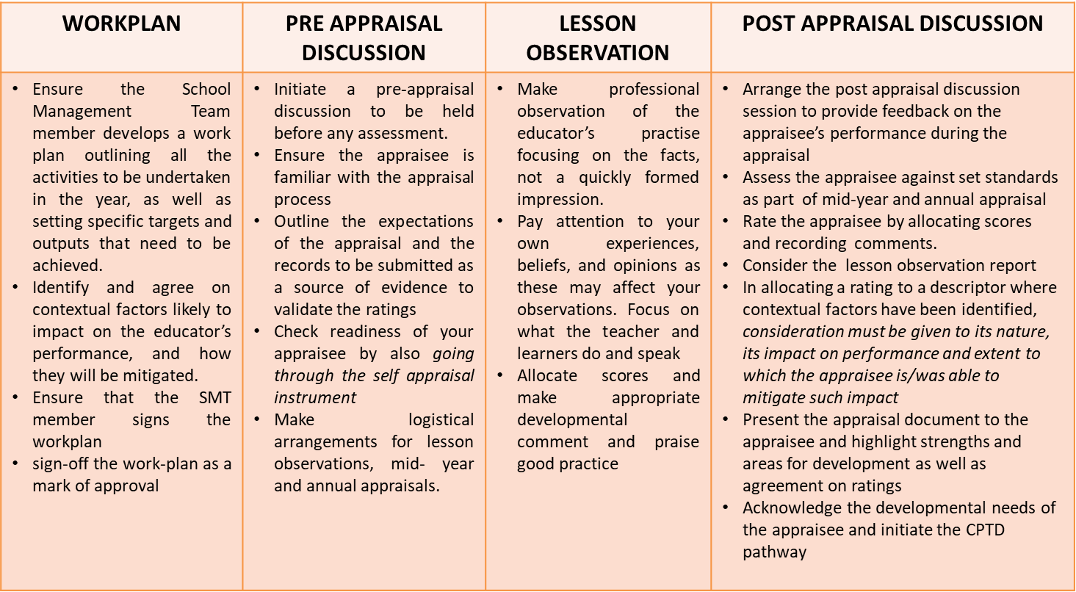
QMS PROCESS: SUPERVISOR RESPONSIBILITES

Slide 9
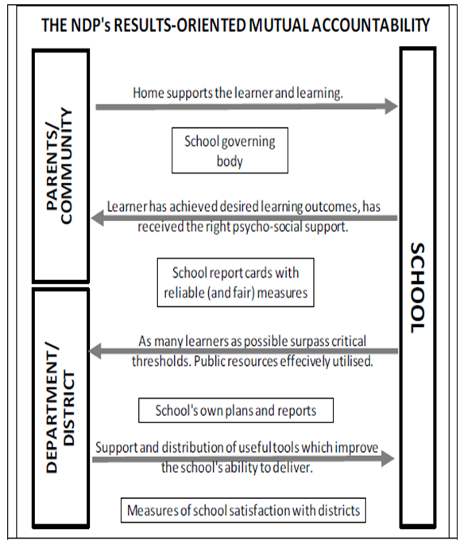
MUTUAL ACCOUNTABILITY
Accountability between school and parents/ community
Importance of support and accountability
Results oriented two-way accountability between districts and schools
districts need to provide useful support and services to schools
schools need to account to districts for the quality of the schooling offered
lines of accountability depend on ‘reliable measures’ of learning outcomes at schools

Slide 10
QMS GUIDING PRINCIPLES
The QMS is a performance appraisal system, not a form filling exercise.
The practice of the educator presenting a self-appraisal for the supervisor to counter sign is not permissible.
The supervisor is in charge of conducting the appraisal and driving the QMS process. The process should be transparent, unbiased and developmental-oriented.
The supervisor should be familiar with the performance standards, criteria and descriptors in the QMS and manage them pro-actively so that a smoother mid and annual appraisal process unfolds.
QMS should not be an activity separate from the day-to-day duties of the supervisor.

