Slide 1
QMS WEBINAR FOR CIRCUIT MANAGERS .
Lesson Observation
MS TEAMS
19 – 22 October 2022

Slide 2
PRESENTATION OUTLINE
Introduction
Purpose of Lesson Observation
PL3 and PL4 Lesson Observation Instrument
Lesson Observation Dos and Donts
Examples of Lesson Observation Reports
Examples of Completed Tools

Slide 3
OUTCOME
At the end of the session participants should understand lesson observations as informed by ELRC Collective Agreement 2 of 2020

Slide 4
INTRODUCTION
Lesson observation refers to a supervisor observing their subordinate’s teaching practice, providing feedback and learning from each other to improve their impact on learning and is focused on improving teaching practice in alignment with learner needs.
Aims to make teaching and learning more visible and encourage colleagues to collaborate to improve teacher practice and student learning
While it is important to tell educators how they can improve, concurrently highlighting their strengths also impacts the quality of their teaching.
Confident educators do better because they have the motivation to keep trying.
Lesson observation undertaken poorly can dent the educator’s motivation

Slide 5
PURPOSE OF LESSON OBSERVATION
Provides effective professional learning that emphasises reflection and feedback on practice to improve teaching and learning
Develops educators’ self-awareness about their own teaching practice and its impact
Confirm (or otherwise) the educator’s perception of their own performance
Can help determine professional learning needs at individual and school level
Supports the development of a common understanding of effective teaching practices that have impact
Supports sharing of ideas and expertise among educators including modelling of good practice
Provides opportunities to discuss challenges and concerns with colleagues
Builds whole-school accountability for the quality of teaching and learning occurring

Slide 6
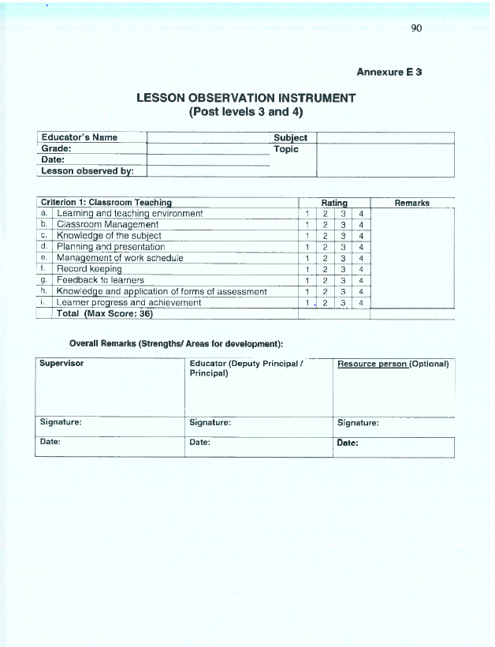
LESSON OBSERVATION FOR PL3 AND PL 4
PL3 and PL4 consists of performance standard 1 and Criterion 1

Slide 7
LESSON OBSERVATIONS: DOs & DONTs
Do: make a commitment to the educator’s professional development
Do: focus on the practice rather than the educator
Do: identify those aspects of the lesson that were the most successful
Do: identify those aspects of the lesson that could be improved
Do: be specific rather than general in your comments
Do: highlight an educator’s strengths
Do: summarise and prioritise your feedback
Don’t: make it personal
Don’t: arrive at the lesson without knowing what it’s about
Don’t: sit in the corner writing an essay, you are there to observe, not write
Don’t: start the ‘feedback’ with 'How do you think the lesson went?
Don’t: leave the teacher with general 'improvement points' e.g. Your assessment for learning needs improvement
Don’t: leave without thanking the educator and agreeing how the observation will be followed up
Don’t: intervene or take over the lesson unless there is an emergency

Slide 8
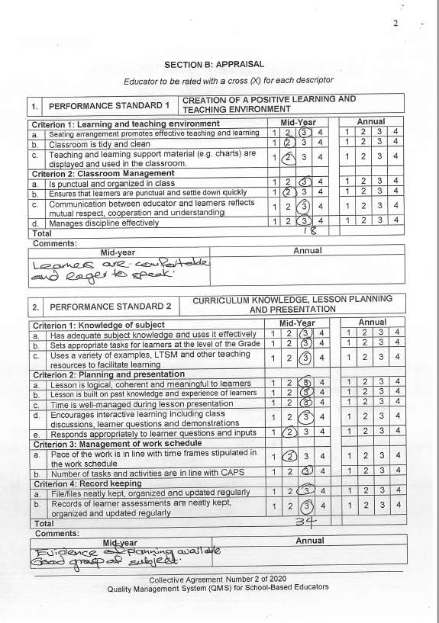
LESSON OBSERVATION EXAMPLES

Slide 9
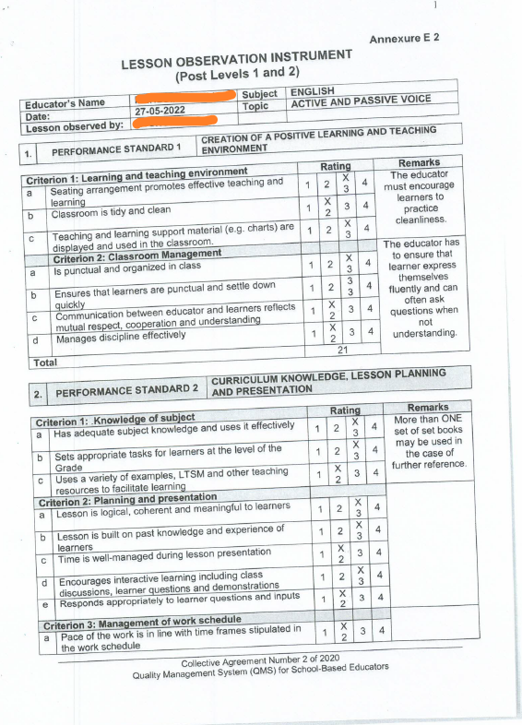
LESSON OBSERVATION EXAMPLES

