Slide 1
QMS WEBINAR FOR CIRCUIT MANAGERS
Development of Workplans
MS TEAMS
19 – 22 October 2022

Slide 2
Presentation Outline
Why principals develop workplans
Performance Standards for the principal’s workplan
Steps to develop a workplan
Lessons learned since 2021
Process to improve development and approval of principals’ workplans by Circuit Managers
Process to improve the development of workplans at school level
Characteristics of a good workplan
Notes:
Over the next 10 minutes we will cover the following related information …..

Slide 3
WHY PRINCIPALS DEVELOP A WORK PLAN
In 2022, all SMT Members developed QMS workplans
Expectation as per Collective Agreement: As immediate supersvisor of the principal, Circuit Manager is required to approve and sign off principals’ workplans by 28 February 2022
In 2021, for the first time, Principals developed and implemented QMS workplans approved by Circuit Managers
A work plan outlines what activities will be undertaken by an employee within a particular year, as well as setting specific targets and outlining outputs that need to be achieved. The workplan forms the basis of the mid and annual appraisal ( which includes Lesson Observation as a component)
ELRC Collective Agreement Number 2 of 2020 requires P2-PL4 school based educators to develop workplans
Notes:
We are reminded that principals are required to develop a workplan as required by CA 2 of 2020 and that a workplan outlines ….
In 2021 for the 1st time principals were required to develop a workplan and this year marked the full implementation of the QMS by all school-based educators. The entire SMT were also required to develop a workplan this year.

Slide 4
Performance Standards for the Principals’ workplans
Principal
Leading the learning school
Shaping the direction and development of the school
Managing quality and securing accountability
Developing and empowering self and others
Managing the school as an organization
Managing human resources (staff) in the school
Management and advocacy of extra-mural activities
Notes:
And you also know that a Principal has to develop a workplan that includes all 7 Performance Standards as indicated here.

Slide 5
STEPS TO COMPLETING A PRINCIPAL’s WORKPLAN
Step 1: State the PERFORMANCE STANDARD
Step 2: State the CRITERIA
Step 3: Identify a DESCRIPTOR
Step 4: Develop the TARGET that is quantifiable and time-bound
Step 5: Indicate TIMEFRAMES
Step 6: Develop a PERFORMANCE INDICATOR
Step 7: State the CONTEXTUAL FACTOR/S relevant to this particular activity. And reflect the unique context of the school
Notes:
I’m sure you are familiar with the following components of a principal’s ( and Deputy Principal’s wirkplan).

Slide 6
Lessons Learned
MOST PRINCIPALS DEVELOPED WORKPLANS
Compliance rates by principals in completing nad submitting a workplan were very high across all provinces
Reluctance by some Circuit Managers to assist on development of workplans for principals who are : Acting principals / rotating in acting roles / principals of merged schools
TEMPLATE USED
Some principals used different templates to that provided in Collective Agreement No.2 of 2020 (Annexure D1) which led to the workplan excluding Performance indicators and Contextual factors
A few sampled workplans were hand written/ manually drawn.

Slide 7
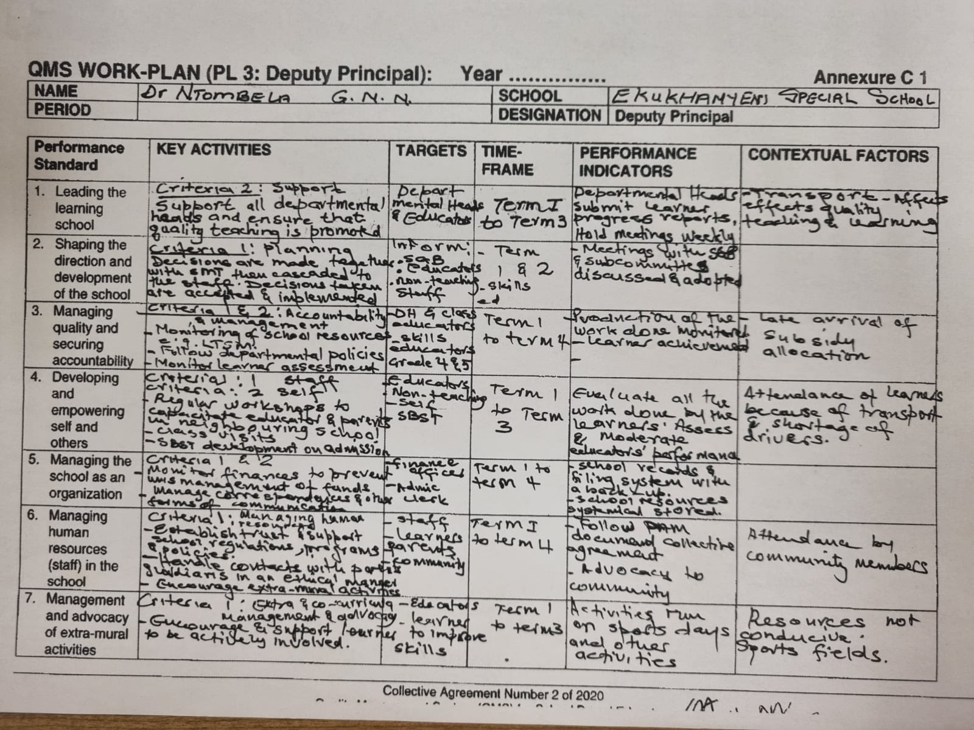

Slide 8
APPROVAL AND SIGN OFF BY CIRCUIT MANAGERS
Across all provinces - Many Circuit Managers signed off work plans without checking that it was technically correct or if the content was correctly reflected on the work plan.
Not all workplans had BOTH the signatures of the principal and Circuit Manager
Dates on which Principal and Circuit Manager signed differed, e.g. the Circuit Manager signed before principal had signed.
Dates were not indicated on some workplans but these were signed.
Some Circuit Managers signed off on the Sample PL4 workplan provided as a resource and not an original workplan

Slide 10
CONTENT OF WORKPLANS
Circuit Managers do not have adequate time or capacity to quality assure the workplans, provide feedback and request corrections.
The approval and sign off was for compliance only.
Incorrect/misunderstood information had not been identified, mediated, or corrected with principals before sign off so principals are aware if they had interpreted the (training) information or workplan template correctly.
The absence of feedback only reinforced the gaps - a real concern is that errors will continue if not corrected through review , discussion and feedback.
Selection of the Criteria per Performance Standard varied among principals. Several did not give enough focus to Performance Standard1(Creation of a Positive Learning Environment), Performance Standard 2 (Curriculum Knowledge, Lesson Planning and Presentation and Performance Standard 3 (Learner Assessment and Achievement).

Slide 11
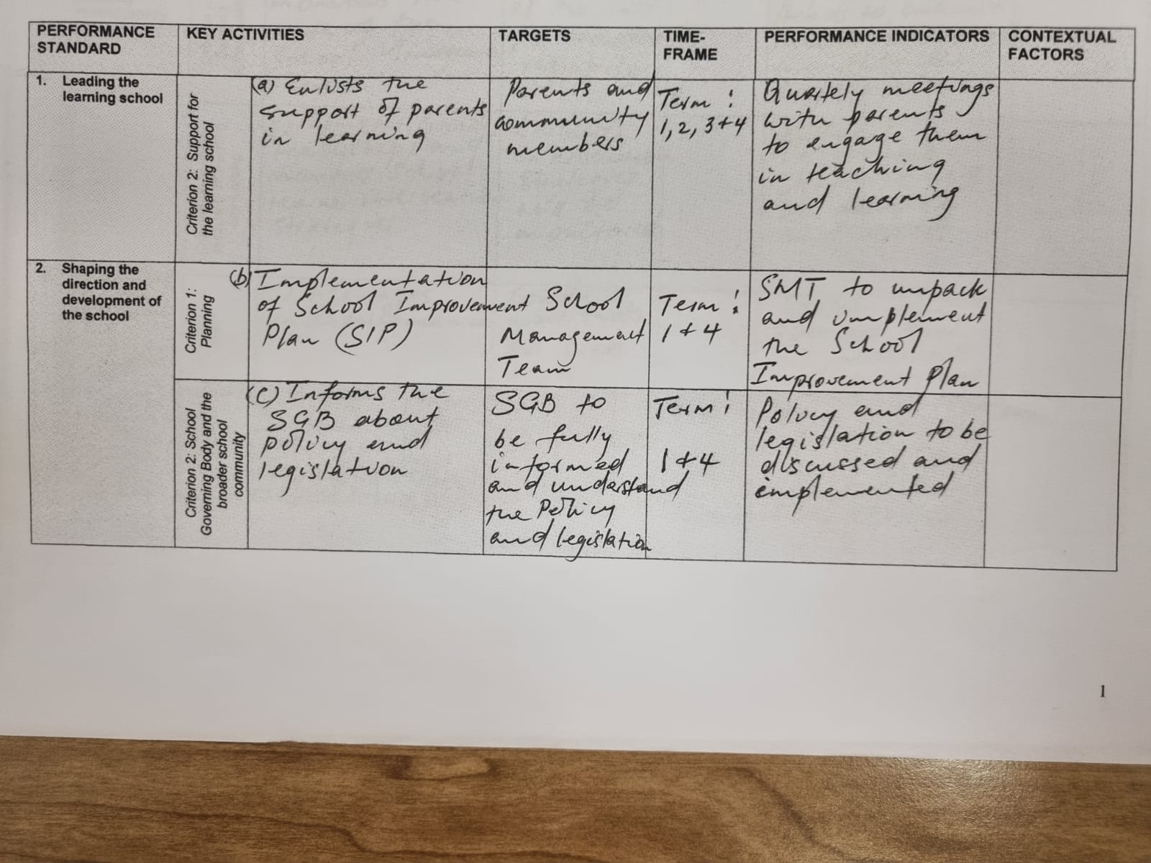

Slide 12
CONTENT OF WORKPLANS
Some principals selected a single descriptor and many chose all descriptors to include on their workplan, whilst some left out the descriptors completely.
In some work plans the Key Activities were not clearly articulated.
Many Circuit Managers and principals did not understand that a TARGET had to be based on the SMART principle and misinterpreted it to be the target group / audience
Many principals were confused between the terminology “targets” and Performance Indicators”
Many principals left the column on the Contextual Factors blank so did not think about the conditions that would help or hinder their achievement of a particular Performance Standard.

Slide 13
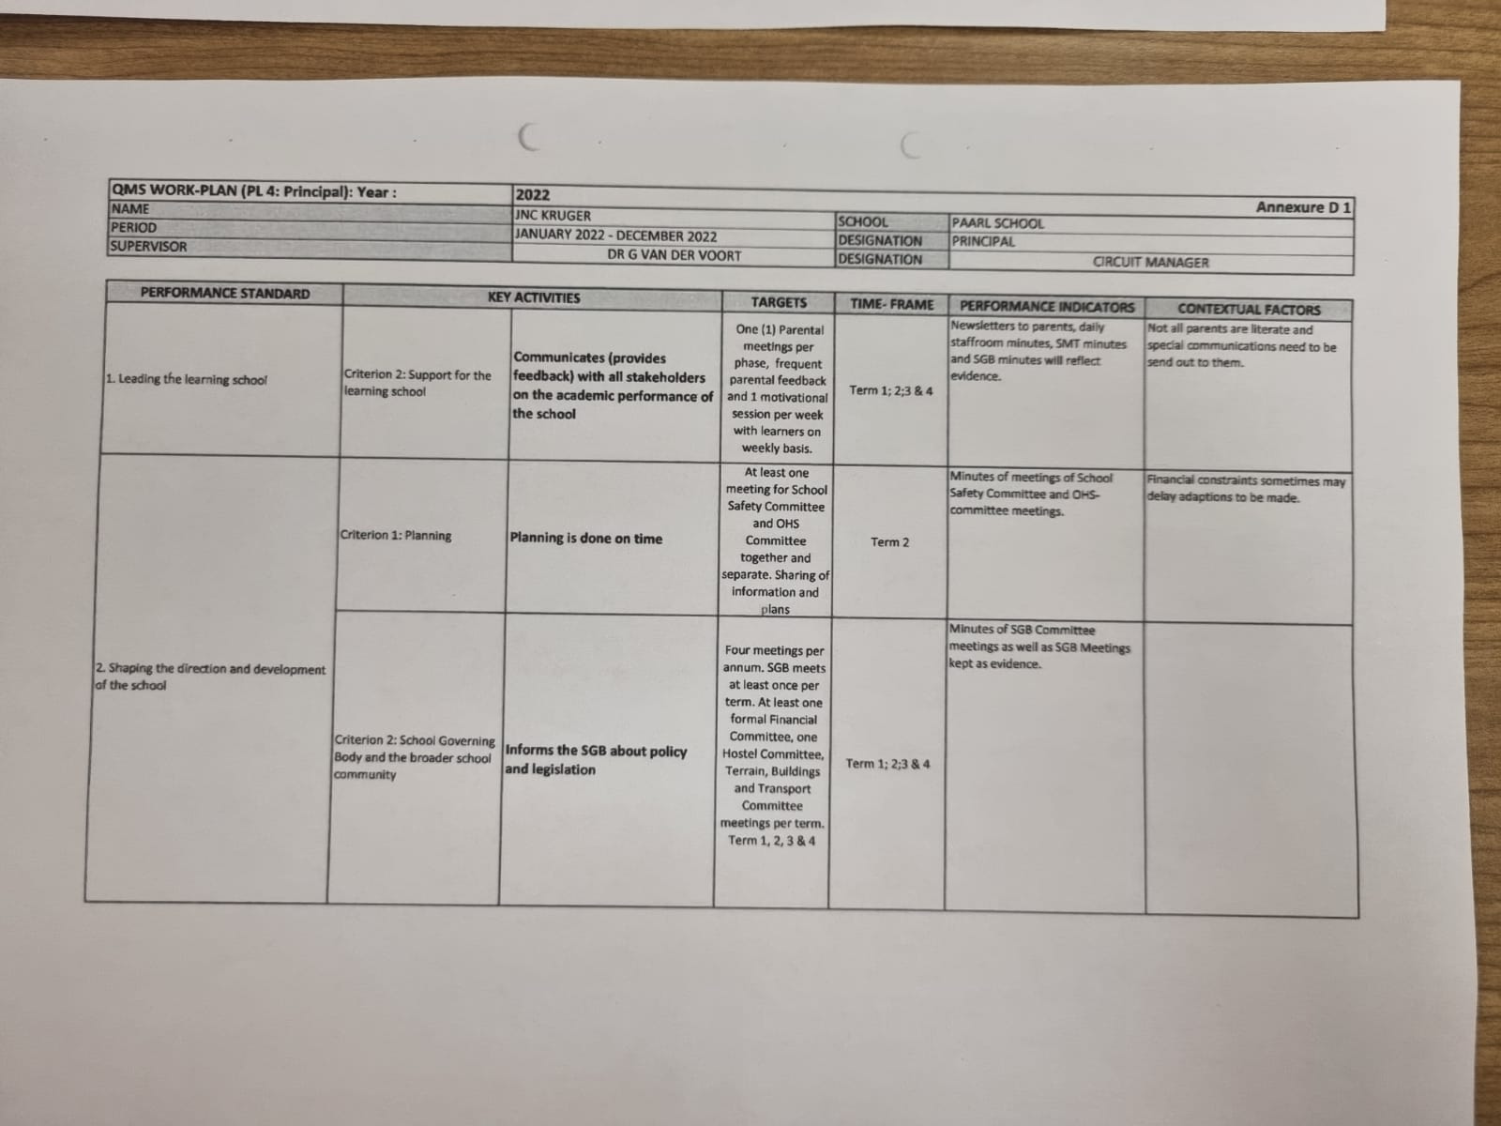

Slide 14
PROCESS TO IMPROVE DEVELOPMENT OF AND APPROVAL OF PRINCIPAL’S WORKPLAN BY CIRCUIT MANAGER
Principal develops draft workplan in alignment with SMT job descriptions and allocated duties
Circuit Manager quality assures workplan (electronically /hard copy and provides feedback to ensure correct content and technical compliance on template
REMOTE / ONSITE / MEETING OF PRINCIPALS
Circuit Manager signs off principal ‘s approved workplan
Principal implements approved workplan – a basis of the appraisal process
Principal submits draft workplan to Circuit Manager for review / feedback /finalisation
Principal hosts SMT review and planning meeting end December – beginning of January
Circuit Manager monitors and supports implementation / review of a principal’s workplan
Notes:
Planning by the principal with the SMT and not in isolation at schools is key.
All principals should ..host …( read 3 bullet points.
Quality assurance is vital to ensure that principals are on the right track, and are developing their workplans correctly, hence the Circuit Manager must quality assure a principal’s workplan ….( read points)
The principal implements a good quality workplan approved by his/ her supervisor .
Monitoring of the implementation of the principal’s workplan is critical to prevent malicious compliance – we want to build a culture of performance management. If there is a weakness at the supervisory level, the commitment of principals can be eroded.

Slide 15
PROCESS TO IMPROVE OF DEVELOMENT OF SMT WORKPLANS AT SCHOOLS
Principal convenes all SMT members to discuss and review job descriptions and allocated duties ; Identify and map contextual factors that will influence achievement of each Performance Standard; Integrate all other plans into the SMT workplans ( SIP/ APIP/ AAPR/ Building Blocks. Etc)
Principal develops workplan with Deputy Principals to ensure alignment of their workplans across the 7 Performance Standards
The Deputy Principals develop their workplans and share with Departmental Heads to guide their workplan development for Performance Standard 6
Monitoring of Workplan implementation
Circuit Manager – Principal
Principal -Deputy Principal
Deputy Principal – Departmental Heads
SMT workplans form basis of the mid-year and annual appraisal process.
SMT conduct review and revision / update workplans where contextual conditions require and are discussed in the respective appraisal process
Notes:
When you meet with school principals , encourage the following processes to improve workplan development and the quality of planning at each school.

Slide 16
Characteristics of a good workplan
The correct workplan template is used
Workplan is developed on Performance Standards 1-7
One descriptor / element or more is selected for each criterion
The targets must comply with SMART principles, and an appropriate measure is provided to assess the achievement/ non achievement of the target
A time-frame is provided for each activity.
The performance indicator (quantitative/qualitative) is neutral and aligned to the activity and target and serves as evidence of that the key activity has been implemented.
Notes:
When you evaluate a workplan and give feedback to a principal , ensure that the workplan has the following characteristics…

Slide 17
Characteristics of a good workplan
Performance indicators should be aligned to activities and targets.
Where applicable and relevant contextual factors are provided as an indication of the localised conditions that help or hinder the achievement of the Performance Standard / implementation of key activities within the unique school environment.
The workplan integrates with other management plans / tools
There is a clear alignment and synergy of the workplans at different post levels (PL4, PL3 and PL2)
Notes:
At the end of this slide …click on the icon and remind the Circuit Managers that this leaflet is to support principals in the development and review of their workplans.

