Slide 1
QMS WEBINAR FOR CIRCUIT MANAGERS
Conducting Appraisals
MS TEAMS
19 – 22 October 2022

Slide 2
Presentation Outline
Key components for the Mid and Annual appraisal of principals
Lessons learned from the field
The Mid & Annual Appraisals
- The inter-related appraisal processes
Getting the most out of the educator appraisals
Dos and Dont’s of the appraisal process
Notes:
In this session we will discuss the following related information …..

Slide 3
Key Components of the Mid and Annual Appraisal of principals
CPD
Self Appraisal
Lesson Observation
Post Appraisal Discussion
Pre- Appraisal Discussion
Notes:
The key components are integrated and are on a continuum of implementation- from the development of the principal’s workplan through to the completion of the annual appraisal.

Slide 4
Lessons from the field: Appraisal of principals
There were high levels of compliance by principals on the completion of the appraisal instruments.
The appraisal of principals by Circuit Managers is not consistent in practice- it varied within districts and across provinces.
Little evidence that Circuit Managers used principal’s workplan as the basis of the appraisal process , together with the completed lesson observation instruments.
There is no strong , consistent evidence of completion of pre-appraisal discussions and post appraisal discussion held with principals (templates/ minutes/ records/ reports).
It was observed in one context that the QMS cycle was adapted: mid-year appraisals were from April and annual appraisals from August.
In another context , lesson observations were conducted at the end of the 2nd term and mid-year appraisals at the beginning of the 3rd term.
Onsite , authentic lesson observation is a challenge due the capacity of circuit managers , vacancies , number of principals per circuit / caretaking of circuits.
Circuit Managers may not be subject specialists- consequently ,completion of lesson observation report and appraisal instruments not done well.
Notes:
The QMS appraisal process is in its 2nd year of implementation for principals , here is what we have learned from our monitoring across provinces :
Read / Summarise points

Slide 5
Mid- Year Remarks by supervisor on Performance Standard 1 : Criterion 1b on Classroom Teaching is vague/ not adequate and does not provide justification for the ratings given
Comment by Supervisor refers to Performance Standard 2 , Criterion 2c only.

Slide 6
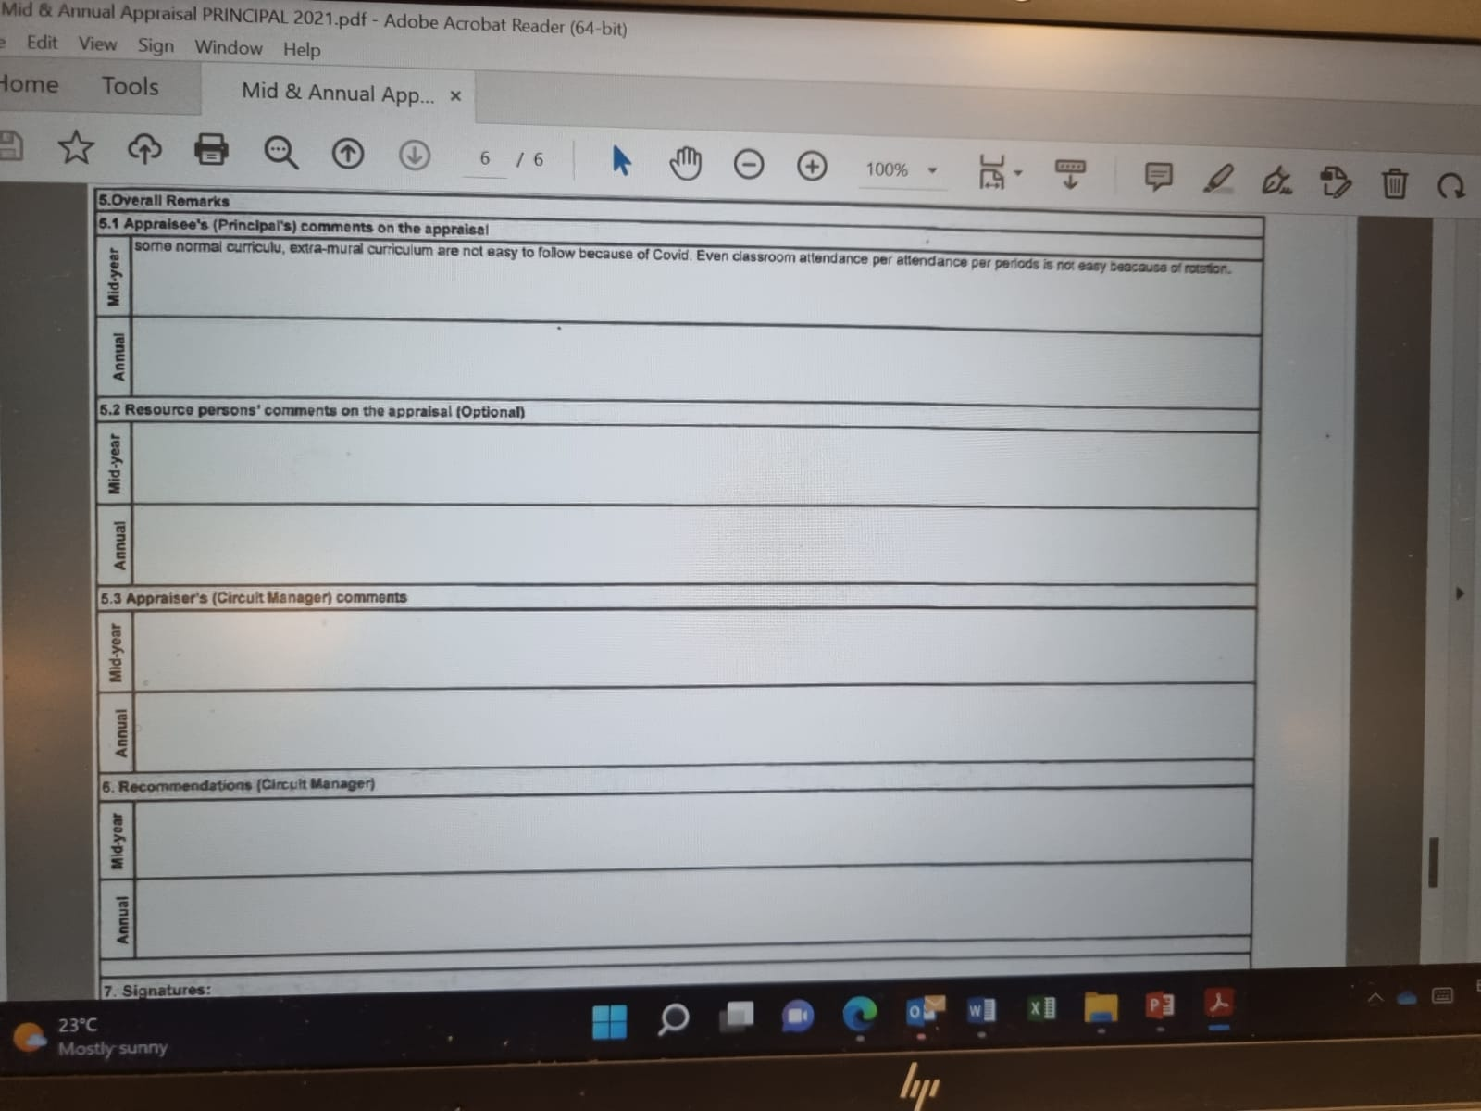
The educator / principal has provided a comment but the supervisor has not in this Mid-Year appraisal. Comment is not reflective in nature.
In the majority of Mid-Year Appraisal Instruments verified – Remarks per Performance Standard and Overall Remarks by the appraisee and supervisor were omitted.

Slide 7
Lessons from the field: Appraisal of principals
Poor correlation between ratings per Performance Standard on a lesson observation instrument and an appraisal instrument ( for Performance Standards 1-3).
Quality and reliability of completed lesson observation instruments
mid-year and annual appraisal instruments is pointing to patterns of
malicious compliance.
There is confusion about the appraisal of Acting Principals/ rotation of acting posts/ how to appraise principals who have been moved to merged / mega schools.
Lack of reliable QMS data collection and reporting systems in place –resulting in inconsistent , late , unconfirmed reporting of approved SMT workplans , completion of the mid-year appraisals.
Concern about lack of synergy / collaboration between QMS District Coordinators and Circuit Managers to ensure complementary roles and responsibilities on QMS monitoring , support , data collection and accountability reporting.
Notes:
Read / summarise points

Slide 8
THE MID-YEAR & ANNUAL APPRAISAL
Formal Appraisals are conducted twice per annum as follows:
Mid-year appraisal:
Conducted towards the end of the second term, taking into account all forms of assessment administered during the first and second term.
Annual appraisal:
Completed by the end of the school calendar year, taking into account all forms of assessment prior to this appraisal.
ELRC Collective Agreement Number 2 of 2020 (page 12)
Notes:
We are familiar with these two formal appraisal process…

Slide 9
THE INTER-RELATED ACTIVITIES THAT FORM THE MID &ANNUAL APPRAISAL PROCESSES
1. SELF- APPRAISAL BY THE EDUCATOR -
2. PRE-APPRAISAL DISCUSSION
3. LESSON OBSERVATION
4. POST APPRAISAL DISCUSSION
5. COMPLETION OF APPRAISAL DOCUMENTS
Notes:
However, it is important to emphasise that the mid year and annual appraisals are part of a set of INTEGRATED activities that comprise the QMS fir principals and SMNTs.

Slide 10
GETTING THE MOST OUT OF EDUCATOR APPRAISALS
Educator Appraisals
1. Make it relevant
2. Encourage ownership and preparation – it must not be done to the educator – but with them
3. Educators do so much – seen and unseen- we must recognise all their work
4. Appraisal is an ongoing process for growth and lifelong learning
5. Follow up appraisal processes with professional development initiatives
Notes:
The appraisal process must have value for every educator . As such we remind you that we need to …..( Read each point)

Slide 11
DOS AND DONTS OF THE APPRAISALS
DO
DON’T
Have a management plan to guide your QMS work throughout the year
Adhere to the timeframes
Be well prepared
Be in the classroom to observe a lesson
Ensure accountability by the supervisor and appraisee for all appraisal activities
Provide Remarks on the appraisal instrument as feedback to the appraisee
Acknowledge innovation, improvisation, good teaching
Identify poor performance and ensure necessary intervention for the appraisee
Monitor correlations between educator scores and learner outcomes at the school
Build a performance management culture
X Promote malicious compliance on the QMS
X Leave out any activities related to the appraisal process
X Leave the Remarks sections blank on the appraisal instrument
X Write remarks that are not related to the ratings selected per Performance Standard
X Sign an appraisal form that does not have feedback to the appraisee
X Forget to identify the CPD needs and ensure capacity building for the appraisee
Notes:
So , how we build on the systems and processes that are already in place ? Here are a few Dos and Don’ts to guide us …
Let’s commit to strengthening the conduct of the appraisal process with integrity so that the summative evaluation score has meaning and is a true reflection of the educator’s work achieved and helps their professional growth trajectory.
Thank you.

